Slide 1

DEMAND FORECASTING FOR WHOLESALE SALES BY INDUSTRY CONSIDERING SEASONALITY IN DEMAND.
Major Research Project, Master of Science in Data Science and Analytics
Mohammad Wahidul Islam Murad
Supervisor: Dr. Saman Hassanzadeh Amin
August 25, 2020

Slide 2
INTRODUCTION AND BACKGROUND
Demand forecasting is the basis for planning supply chain activities.
Select effective forecasting technique that is appropriate on specific time-series data set.
Many active researches are going on different forecasting techniques.
In this Major Research Project,
Predict demand for different wholesale products by industry type under the North American Industry Classification System (NAICS).
Measure performances between actual and predicted data based on different forecasting models.

Slide 3
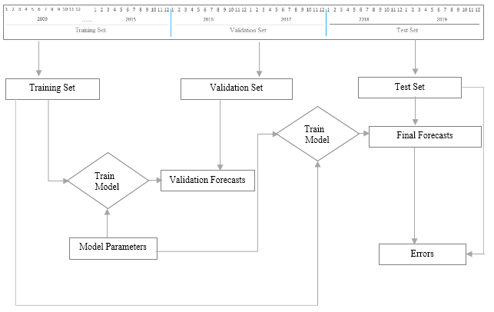
METHODOLOGY AND EXPERIMENTS
The dataset that used in this project is divided into three parts.
Train set from year 2009 to 2017.
Validation set from year 2016 to 2017
Test set from year 2018 to 2019.
Initially, the predictions were performed on train and validation sets.
Identify the best hyper parameter settings that provide minimum RMSE and MAPE values between actual and predicted data.
Finally, predictions were performed on train and test sets.
Figure: Experimental design

Slide 4
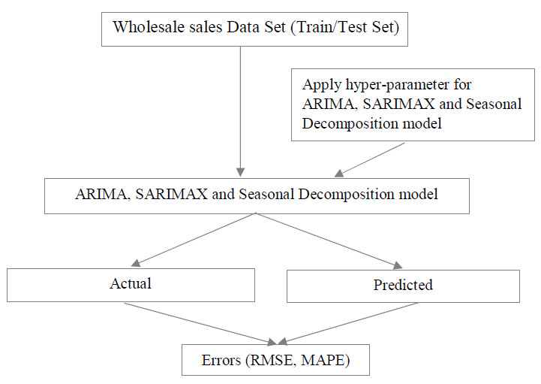
METHODOLOGY AND EXPERIMENTS (CONT.)
In this project three forecasting models were used.
Experiment 1: ARIMA (Autoregressive Integrated Moving Average)
Experiment 2: SARIMAX (Seasonal Auto Regressive Integrated Moving Averages with eXogenous regressor)
Experiment 3: Seasonal Decomposition
Evaluate Model Performances:
Root Mean Square Error (RMSE)
Mean Absolute Percentage Error (MAPE)
Figure: Forecasting techniques and error measurements

Slide 5
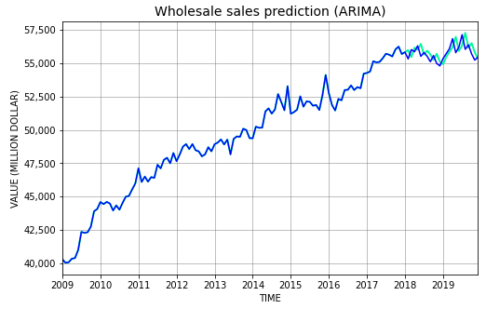
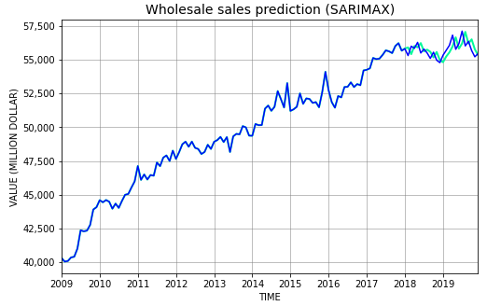
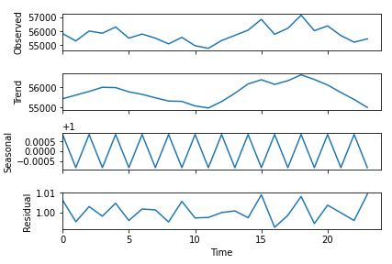
RESULTS
According to the hyper parameter settings from validation result below parameter settings were applied on total wholesale sales and 23 different wholesale products.
Experiment 1: ARIMA model (p, d, q) = (0, 1, 0).
Experiment 2: SARIMAX model (p, d, q) = (6, 1, 1).
Experiment 3: Seasonal Decomposition Model ‘freq’ = 12 (Monthly data).
According to the result from ARIMA and SARIMAX, SARIMAX model shows better performing compared to ARIMA.
Figure: ARIMA model for total wholesale sales
Figure: SARIMAX model for total wholesale sales
RMSE and MAPE between actual and predicted data on total wholesale sales
Figure: Seasonal Decomposition model

Slide 6
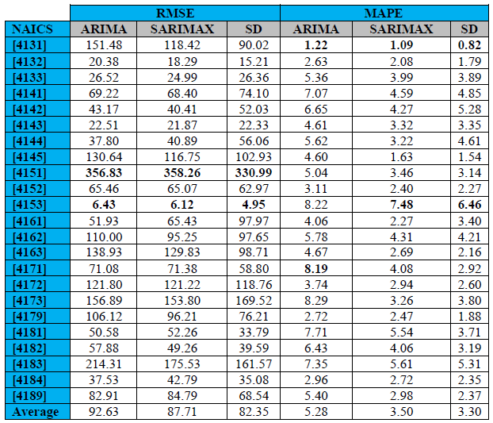
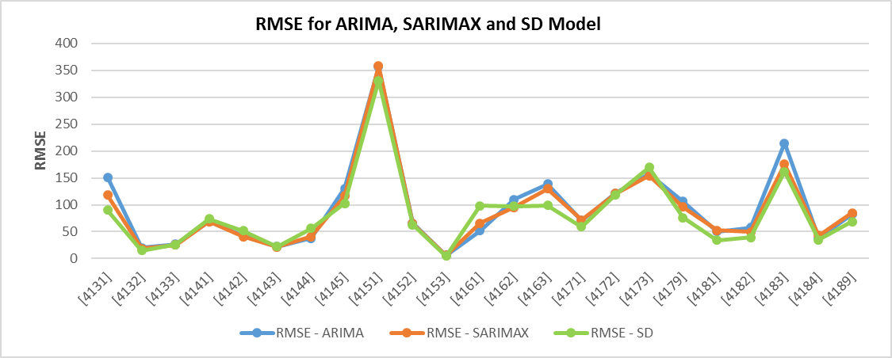
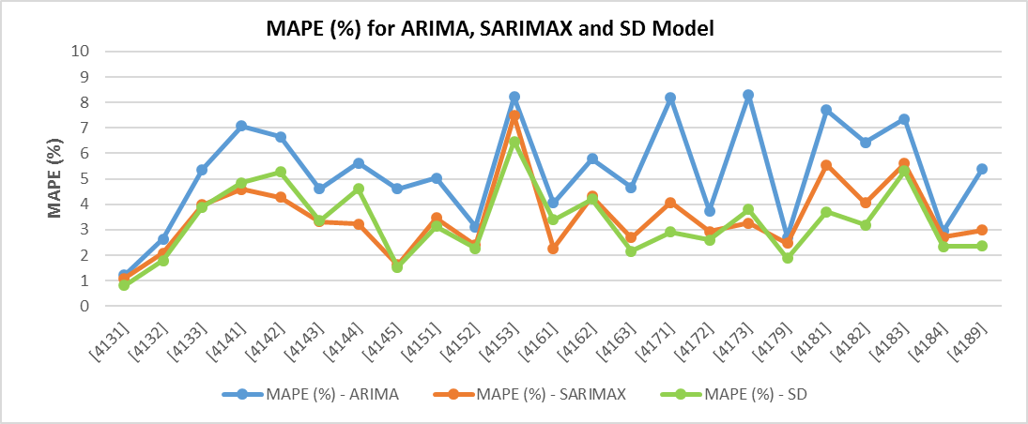
RESULTS (Contd.)
Below result from three time-series forecasting models ARIMA, SARIMAX and Seasonal Decomposition applied on 23 different wholesale products.
In the case of MAPE, SARIMAX model gives the minimum errors for all wholesale sales product type.

Slide 7
CONCLUSION
SARIMAX is the best model to predict the wholesale sales data. Seasonal Decomposition model gives the minimum number of errors, but this model has no feature to consider previous values.
The forecasting models were implemented independently without considered merging or ensemble methods. In future research include an ensemble method to combine different forecasting techniques and minimize the errors between actual and predicted data.
The future work will anticipate geographical location, population and weather as external attributes to build the inimitable model that can help to forecast the specific type of time series data.

Slide 8
DATA SOURCE AND GITHUB LINK
In this major research project, the datasets that used in this project has been downloaded from Statistics Canada website.
Dataset Link: https://www150.statcan.gc.ca/n1/tbl/csv/20100003-eng.zip
Pyhton code used to analyze the wholesale sales data and implement different forecasting models to evaluate the performances.
Github Link: https://github.com/wimurad/DS_MRP_2020

Slide 9
REFERENCES
In this major research project different references from published journal and paper used in the area of sales forecasting in supply chain management and implementation using different forecasting models and machine learning algorithms.
Details of references are included in the major research project report.
MRP Report Link: https://github.com/wimurad/DS_MRP_2020/blob/master/MRP_Report_Mohammad%20Murad.pdf

Slide 10

QUESTIONS AND ANSWERs

Slide 11

Thank You

